Slide 1

The Scrum-Agile approach to software development
How the agile process works and why you should start using it

Slide 2
Agile Roles
Product owner
Scrum master
Developer

Slide 3
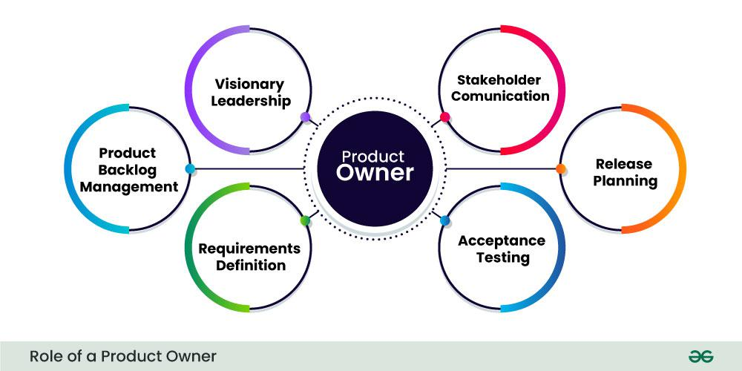

Slide 4
Product Owner
The product owner needs to represent the client stakeholders during meetings to create goals and requirements for the project.
They need to communicate the needs and priorities of the application to the development team.
The product owner defines the requirements of the project and manages the product backlog.

Slide 5
Scrum Master
The scrum master is responsible for understanding the team’s needs to coordinate meetings and create a productive and inclusive environment for the developers.
Consults with the product owner to organize the structure of requirements and sprints for the team and ensure a good standing with stakeholders.
Coaches on good practices in the agile framework and mitigates conflicts that arise between team members.

Slide 6
Developer
The development team is made up of programmers that implement the goals of each sprint by coding the application according to the specified needs communicated by the product owner.
Developers need to understand goals and communicate with each other to ensure functionality and compatibility in software practices.
Developers need assistance from the product owner to know the requirements and from the Scrum master to have a clear goal and minimal distractions during development.

Slide 7

Agile Phases
Requirements Gathering: This phase involves the product owner and stakeholders gathering information of what is needed for the project
Planning: This phase has the development team planning to create the features for each iteration of the project
Development: This is when the development teams creates the product as defined by the previous requirements and plans
Testing: Now the software is put through rigorous testing to ensure it is scalable and functional at all required levels
Deployment: The website or application is now live
Maintenance: The team continues to integrate features, updates for performance, and bug fixes.

Slide 8
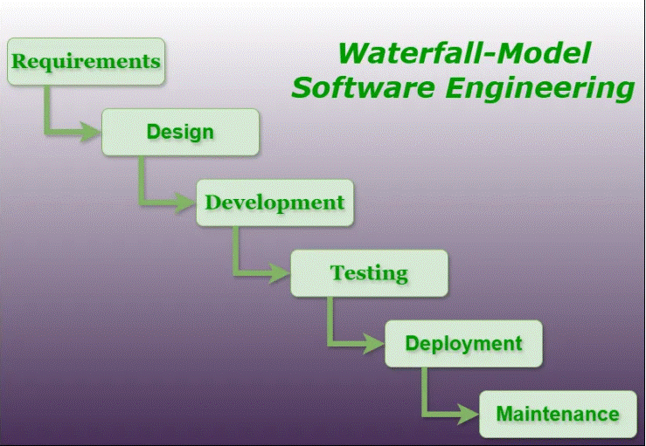

Slide 9

The waterfall pitfall
The waterfall model would have been very difficult for the team to work in. This framework doesn’t allow us to adapt to changes when new goals are created or when clarifications need to be made.
“The Myki ticketing system project in Melbourne, Australia, starkly underscores the Waterfall method’s rigidity. With a budget exceeding AUD 1.5 billion, the project took four times more than the expected two years. Yet, the system was riddled with issues due to its inability to adapt to evolving user requirements and technological advancements.” (Nieto-Rodriguez, It's time to end the battle between Waterfall and Agile 2023)

Slide 10
Choosing your workflow
It is important to keep in mind the rigid structure of the waterfall model as it pertains to the ability to work in a changing world with growing technological advances.

Slide 11
Choosing your workflow
“In conclusion, both Agile and Waterfall methodologies have proven their value across different industries, but their effectiveness depends largely on the specific context of the project. Agile is better suited for projects where flexibility, collaboration, and customer feedback are paramount, while Waterfall remains essential for projects requiring strict documentation, phase control, and stable requirements.” (Sirisha, Mrs & Sarada, Vani & John, Dr & Ramakrishna, B & Bisen, Dineshwari & Haralayya. A comparative analysis of agile and Waterfall Approaches)

Slide 12
Choosing your workflow
“Working on agile teams can also help prepare functional managers—who rarely break out of their silos in today’s overspecialized organizations—for general management roles. It exposes them to people in other disciplines, teaches collaborative practices, and underscores the importance of working closely with customers—all essential for future leaders.” (Rigby et al., Embracing agile 2024)

Slide 13
References
GeeksforGeeks. (2024, August 4). Product owner: Introduction, roles & responsibilities, and Skills. https://www.geeksforgeeks.org/product-owner-definition-roles-and-responsibilities/
GeeksforGeeks. (2024b, October 18). Waterfall Model - Software Engineering. https://www.geeksforgeeks.org/waterfall-model/?ref=shm
Rigby, D., Sutherland, J., & Takeuchi, H. (2024, December 5). Embracing agile. Harvard Business Review. https://hbr.org/2016/05/embracing-agile
Nieto-Rodriguez, A. (2023, October 16). It’s time to end the battle between Waterfall and Agile. Harvard Business Review. https://hbr.org/2023/10/its-time-to-end-the-battle-between-waterfall-and-agile
Sirisha, Mrs & Sarada, Vani & John, Dr & Ramakrishna, B & Bisen, Dineshwari & Haralayya, Dr. (2024). Project Management Methodologies: A Comparative Analysis of Agile and Waterfall Approaches. Library Progress (International). 44. 17237-17246.

